Slide 1
Implementation of CNN-based Word Recognition System
TEAM MEMBERS:
19R21A0462 – B . Sai Kiran
19R21A04B0 – Satya Prakash Dash
19R21A0463 – B . Shashanth
19R21A0497 – O . Pradeep
Project Guide: Mr. Bittu Kumar(Assistant Professor)

Slide 2


List of Content
AIM AND OBJECTIVES
ABSTRACT
MOTIVATION
INTRODUCTION
LITERATURE SURVEY
TOOLS REQUIRED
METHODOLOGY
RESULTS
ADVANTAGES
DISADVANTAGES
CONCLUSIONS
FUTURE SCOPE
REFERENCES

Slide 3
AIM AND OBJECTIVES
AIM:
To develop a Word Recognition System for deaf and dumb people.
OBJECTIVE:
Objective is to develop a low cost efficient system which is helpful for deaf & dumb people.

Slide 4
Abstract
Sign language is used by deaf and hard hearing people to exchange information between their own community and other people.
Sign language is one of the oldest and most natural form of language for communication.
Since most people do not know sign language and interpreters are very difficult to come by we have come up with a real time method using neural networks.

Slide 5
Cont…
Sign Language Recognition (SLR) deals with recognizing the hand gestures and continues till text or speech is generated for corresponding hand gestures.
This work focused on recognizing the hand gestures which includes 26 English alphabets (A-Z) and 10 digits (0-9) using Convolutional Neural Networks (CNN).
The problem addressed is based on Digital Image Processing using Skin Detection, Image Segmentation, Image Filtering.

Slide 6
Motivation
The main motive of this project is to contribute to the field of automatic sign language recognition and translation to text or speech.
Sign language uses lots of gestures so that it looks like movement language which consists of a series of hands and arms motions.
Based on these sign languages are made up of two groups, namely static gesture, and dynamic gesture. The static gesture is used for alphabet and number representation, whereas the dynamic gesture is used for specific concepts.

Slide 7
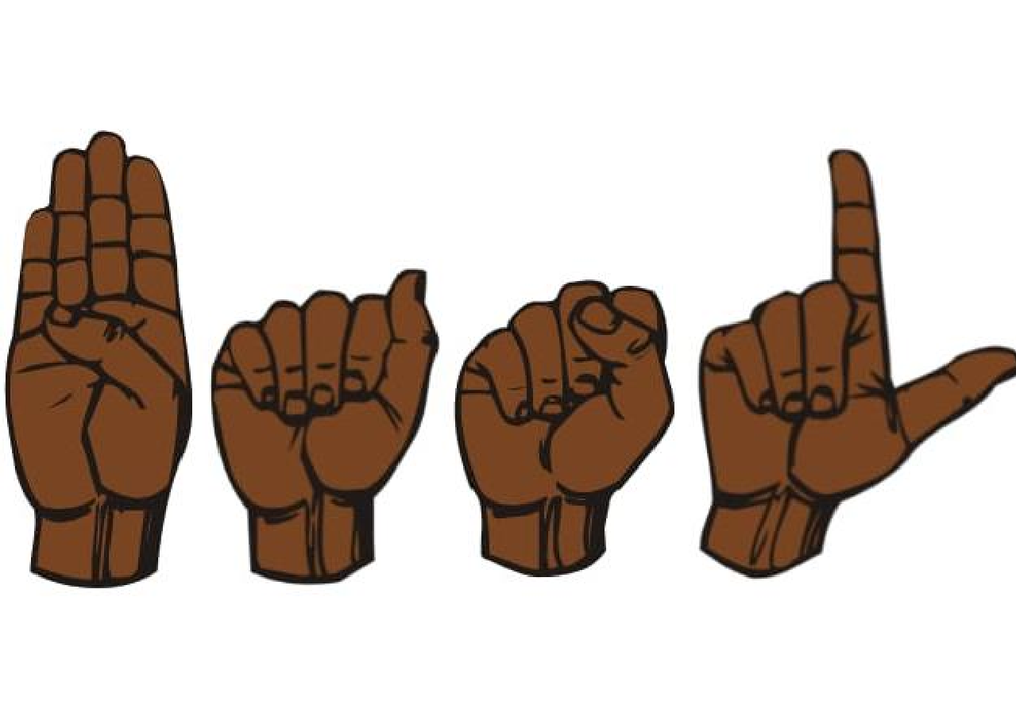
Introduction
Hand gesture recognition for human computer interaction is an area of active research in computer vision and machine learning.
One of its primary goals is to create systems, which can identify specific gestures and use them to convey information.
Though, gestures need to be modelled in the spatial and temporal domains, where a hand posture is the static structure of the hand and a gesture is the dynamic movement of the hand.

Slide 8
Introduction
There are basically two types of approaches for hand gesture recognition: vision-based approaches and data glove approaches.
This work main focus is on creating a vision-based system able to do real-time sign language recognition. The reason for choosing a system based on vision relates to the fact that it provides a simpler and more intuitive way of communication between a human and a computer.
Being hand-pose one of the most important communication tools in human’s daily life, and with the continuous advances of image and video processing techniques, research on human-machine.

Slide 9
Literature Survey
Journal Title :
Multi-Linguistic Sign Language Recognition System
Institute of Electrical and Electronics Engineers(IEEE)
ISSN : 978-1-7281-0110-1

Slide 10
Literature Survey
S.No | Journal Type with year | Authors | Title | Outcomes
1 | 2nd IEEE International Conference on Knowledge Innovation and Invention 2019 | Md Abdur Rahim, Jungpil Shin, Md Rashedul Islam | Dynamic Hand Gesture Based Sign Word Recognition Using Convolutional Neural Network with Feature Fusion | This paper provides similar techniques related to our project.
2 | 8th International Conference on Reliability, Infocom Technologies and Optimization | Pushan Kumar Datta, Abhishek Biswas, Ahona Ghosh, Nilanjana Chaudhury | Creation of Image Segmentation Classifiers for Sign Language Processing for Deaf and Dumb | The proposed solution has been carried out around the world on sign language recognition, for many sign languages.
3 | IEEE International Conference on Automation Science and Engineering | Hsien-I Lin, Ming-Hsiang Hsu, Wei-Kai Chen | Human Hand Gesture Recognition Using a Convolution Neural Network | The proposed solution meet the convolution neural network (CNN) method to recognize hand gestures of human task activities from a camera image.

Slide 11
Cont...
This paper presents the design and implementation of Multi-Linguistic sign language model with Python Image Processing.
This implementation is based on Matlab Software, a multi linguistic model.
This features a computer tool box functions to determine the results, besides USB webcam support package and image processing tool box also have a key role in implementation.

Slide 12
Cont…
Dynamic Hand Gesture Based Sign Word Recognition Using Convolutional Neural Network with Feature Fusion
This paper proposes a hand gesture recognition system using convolutional neural networks (CNNs). The system uses a combination of hand shape and motion features extracted from the input hand gesture frames to train a CNN. The proposed system achieves an accuracy of 95% on the hand gesture recognition task.

Slide 13
Cont…
A Novel Framework for Dynamic Hand Gesture Recognition Using Convolutional Neural Networks and Hidden Markov Models" by Li Li et al. (2017)
This study proposed a framework for dynamic hand gesture recognition that uses CNNs and hidden Markov models (HMMs). The CNN is used to extract features from the hand gesture frames, and the HMM is used to model the temporal dynamics of the gestures. The system achieved an accuracy of 96.5% on the dynamic hand gesture recognition task.

Slide 14
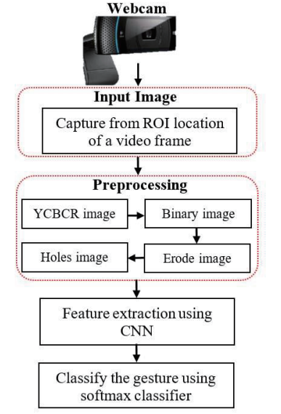
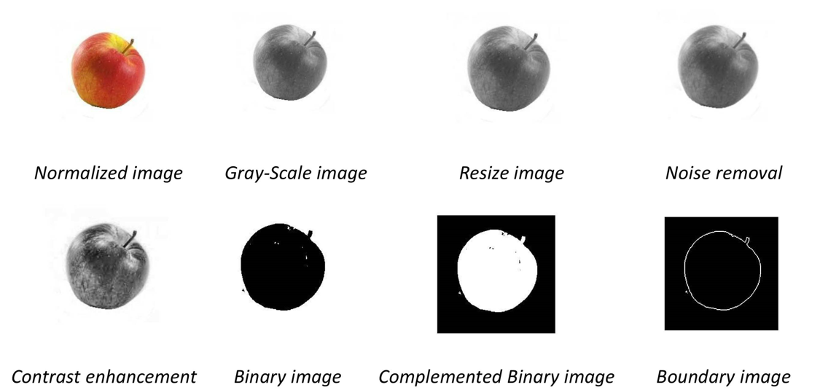
Block Diagram

Slide 15

Tools Required
System with webcam
Python
Tensor Flow
Keras
OpenCV or cv2
Media Pipe

Slide 16
Step by step process
Acquisition of image through web cam.
Detecting the part where only image of hand is required.
In next we use pre processing technique where RGB image is converted into gray scale image.
Segmentation, this part is used to determine the location of temporal boundaries of hand image that has been captured by a camera is segmented to obtain the hand area.
Feature Extraction, the hand gestures themselves are rich in variation of shapes, motions, and textures & also binary information of image.

Slide 17
Cont…
Various classification algorithms are used: SVM, k-NN and CNN, so here we used CNN technique.
CNN - Convolutional Neural Networks(CNN) are the go-to choice for an image classification problem, is an artificial neural network consisting of convolutional layers, works well with the image data.
Trained imaged will be stored in database and classified.
The tested image compared with trained dataset models, so image with higher accuracy will be output in form of text.

Slide 18


Methodology
Hand Detecting
Image Acquisition
Pre-Processing
Segmentation
Feature Extraction
(CNN Model)
Output
Classification
Training

Slide 19
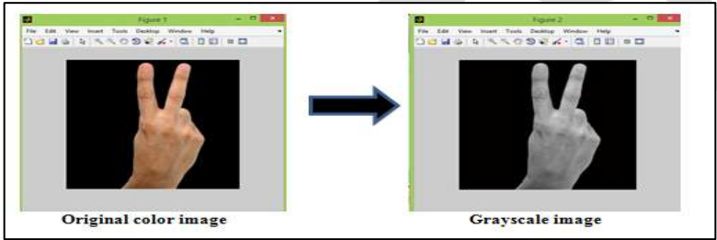
Methodology
The general aim of Image Acquisition is to transform an optical image (Real World Data) into an array of numerical data which could be later manipulated on a computer.
In pre processing RGB image converted into grayscale image.

Slide 20
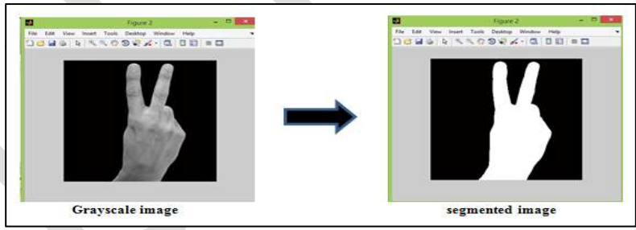
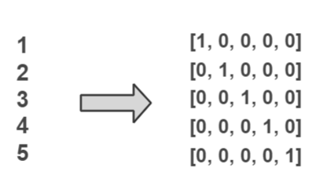
Methodology
Image segmentation is a method of dividing a digital image into subgroups called image segments by boundaries reducing the complexity of the image and enabling further processing or analysis of each image segment.
Feature extraction refers to the process of transforming raw data into numerical features that can be processed while preserving the information in the original data set. Feature extraction has functions like Detect, Extract, Matching & Storing features.

Slide 21
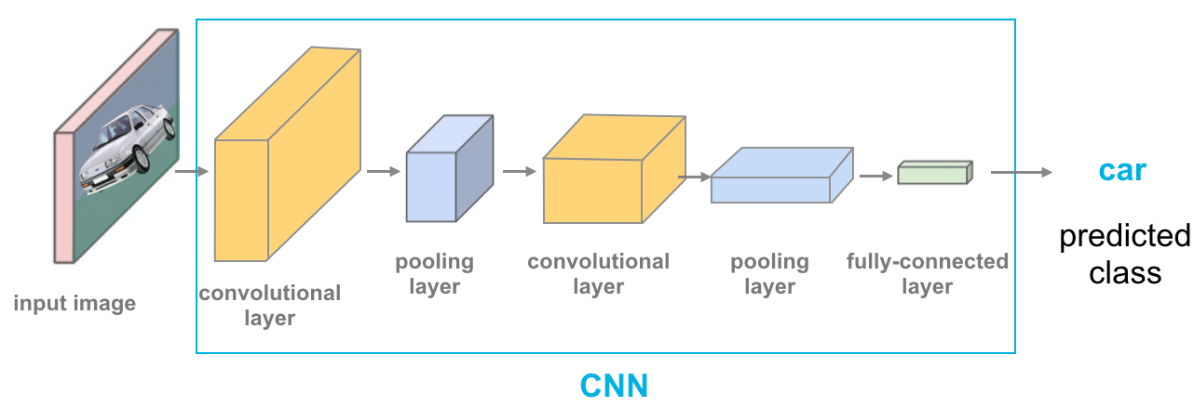
Methodology
Convolutional Neural Networks (CNN), are deep neural networks used to process data that have a grid-like topology, e.g images that can be represented as a 2-D array of pixels. A CNN model consists of four main operations: Convolution, Non-Linearity (Relu), Pooling and Classification (Fully-connected layer ).

Slide 22

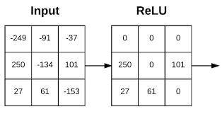
Methodology
Convolution: A convolutional layer is the main building block of a CNN. It contains a set of filters (or kernels), parameters of which are to be learned throughout the training. The size of the filters is usually smaller than the actual image. The objective of the Convolution Operation is to extract the high-level features such as edges, from the input image.
Relu (Rectified Linear Unit) : It is an element-wise operation that replaces all negative pixel values in the feature map by zero. Its purpose is to introduce non-linearity in a convolution network.

Slide 23

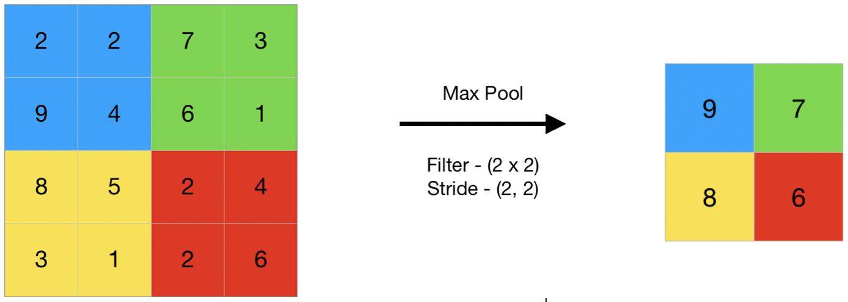
Methodology
Pooling: Pooling (also called down-sampling) reduces the dimensionality of each feature. It reduces the amount of information in each feature obtained in the convolutional layer while maintaining the most important information.

Slide 24
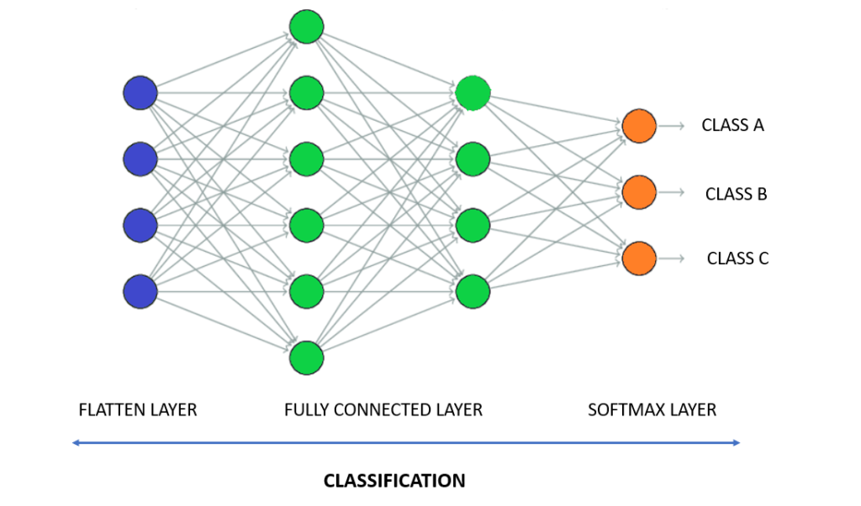
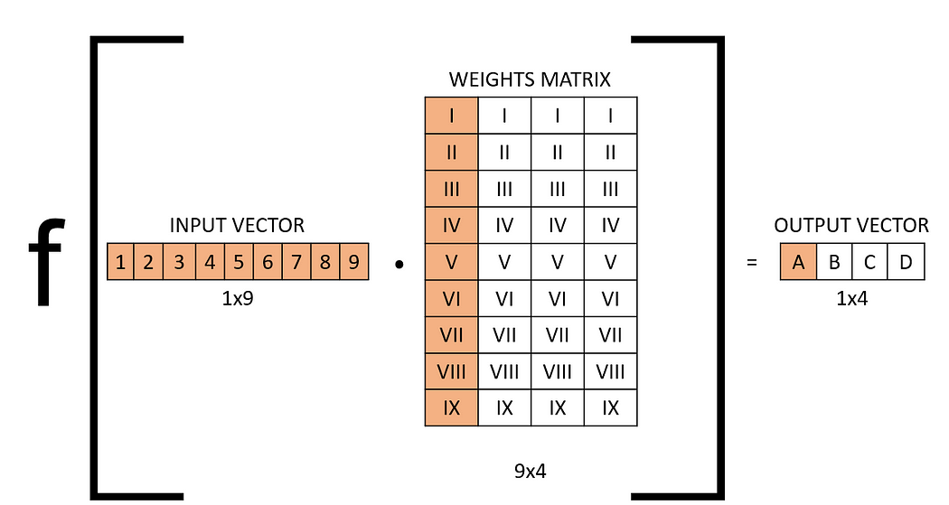
Fully-connected layer: It is a multi layer perceptron that uses soft max function in the output layer. It takes the output of the previous layers, “flattens” them and turns them into a single vector that can be an input for the next stage.

Slide 25
Methodology
Training is the process of training data & storing them in data base and classification is the process of categorizing and labeling groups of pixels.
The image to be tested is matched with stored data in data base and provides accuracy, so image with higher accuracy will be in form of text output.

Slide 26
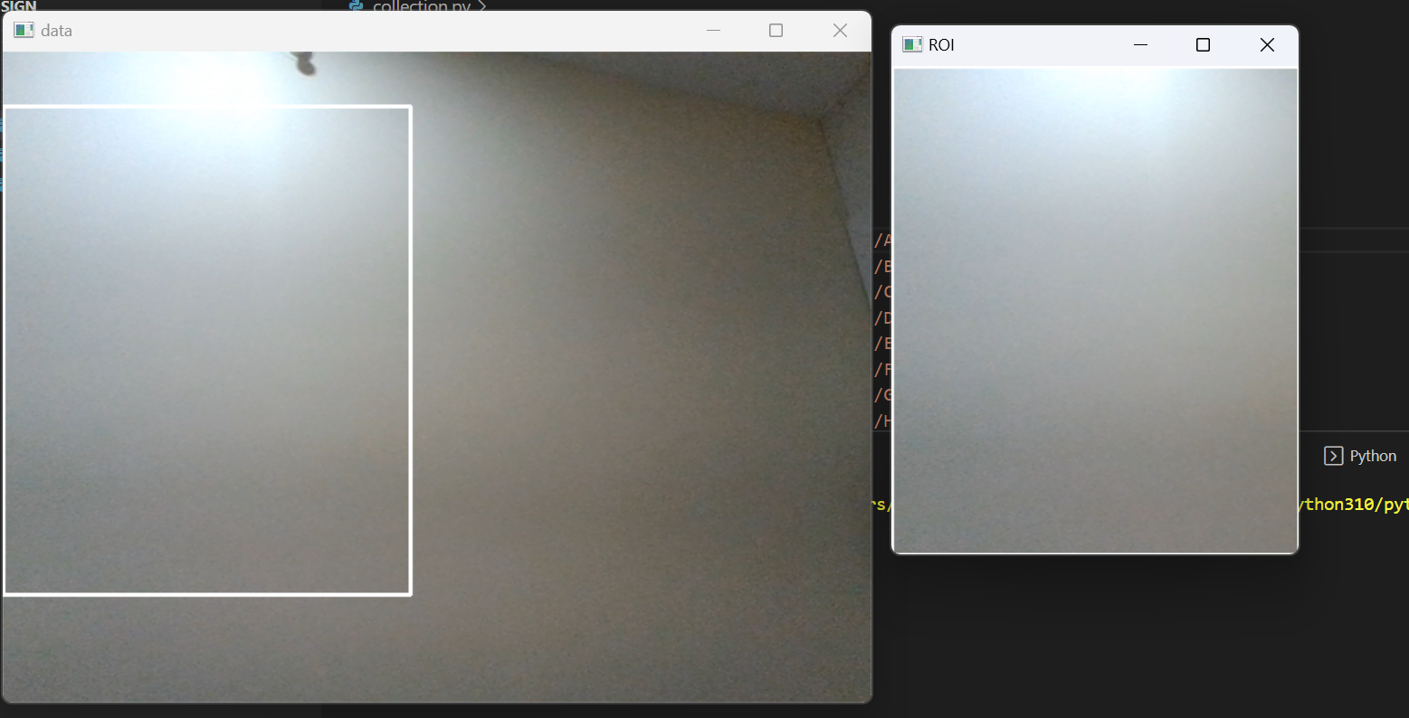
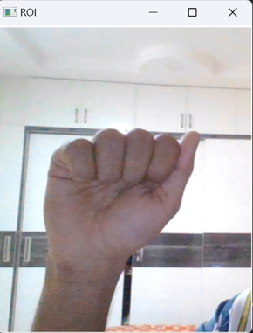
Results
Raw image is collected through web cam of ROI detecting the part where only image of hand is required.
Here hand gesture for A is collected.

Slide 27
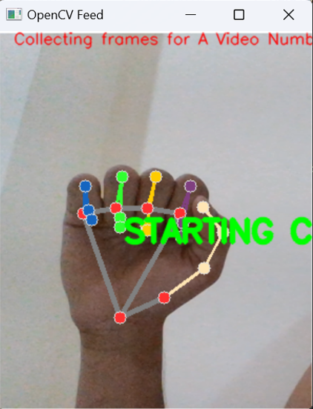
Cont..
Then the image is functioned to various methods like grey scale image, blur image. A webcam-captured hand image has been separated to get the hand region. The shapes, actions, and materials used in the various hand gestures vary & also, binary information of image.
In this step the .png image is changed into a.npy file (matrix form), which includes a variety of properties to function under many circumstances. Here the data frames are collected.

Slide 28
Cont..
Since they operate well with image data, CNNs, or artificial neural networks made up of convolutional layers, are the approach of choice for challenges involving image categorization. The categories training photographs were saved in the database. The image with the highest accuracy was generated as text after comparisons between the tested image and training dataset models.

Slide 29
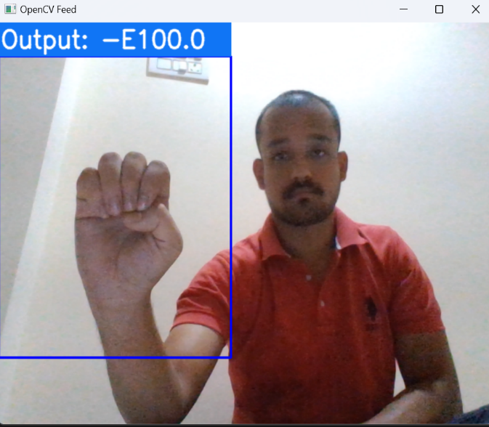
Cont..
In output image orange arrow represents alphabet and green arrow represents accuracy of image.
s
of image.

Slide 30
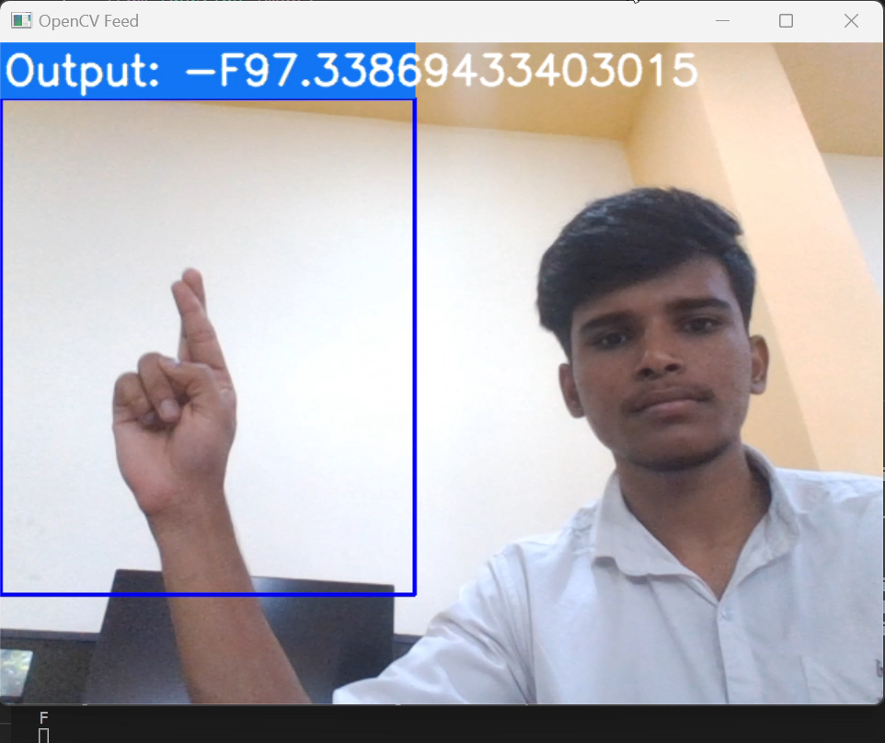
Result

Slide 31
Advantages
Useful for deaf and dumb people.
Quick expressing of messages.
People can easily interpret the gesture of another person.
Alternative computer interfaces.
Used in sign language translation.
Entertainment applications and automation systems.

Slide 32
Disadvantages
Some gestures are difficult in understanding information might get distorted.
Cannot make long explanation or conversation through it.
It is one of the informal types of communication, where it is not suited for official purpose.

Slide 33
Conclusion
This method has used images to discuss the gestures classification to recognition of gestures.
The solution in this paper depends entirely on the shape parameters of the hand gesture.
The implemented framework is effective in adjusting the lighting as well as the gesture orientation.

Slide 34
Future Scope
We are planning to achieve higher accuracy even in case of complex backgrounds by trying out various background subtraction algorithms.
We are also thinking of improving the preprocessing to predict gestures in low light conditions with higher accuracy.

Slide 35
References
[1] G. Marin, F. Dominio, and P. Zanuttigh. "Hand gesture recognition with jointly calibrated leap motion and depth sensor." Multimedia Tools and Applications, vol. 75, no. 22, pp. 14991-15015, Nov. 2016.
[2] P. Kumar, H. Gauba, P.P. Roy, and D.P. Dogra. "Coupled HMM-based multi-sensor data fusion for sign language recognition." Pattern Recognition Letters, vol. 86, pp. 1-8, Jan. 2017.
[3] F.S. Chen, C.M. Fu and C.L. Huang. "Hand gesture recognition using a real-time tracking method and hidden Markov models." Image and vision computing, vol. 21, no. 8, pp. 745-758, Aug. 2003.
[4] D. Lifeng, R. Jun, M. Qiushi, W. Lei, “The gesture identification based on invariant moments and SVM[J].” Microcomputer and Its Applications, vol. 31, no. 6, pp. 32-35, 2012.
[5] M.A. Rahim, T. Wahid, M.K. Islam, “Visual recognition of Bengali sign language using artificial neural network.” International Journal of Computer Applications, vol. 94, no. 17, Jan. 2014.

Slide 36
THANK YOU

